Slide 1
College Planning Workshop for Parents
Class of 2021

Slide 2
Office of College Counseling
Mr. Kevin Gonzalez, Director of College Counseling
krandolphgonzalez@ciceroprep.org
Updated College Counseling Events:
https://ciceroprep.greatheartsamerica.org/academics/college-counseling/
Juniors required to have 1:1 meeting before April 30 (Zoom, Skype, WhatsApp)

Slide 3
What we know
Flexible admission testing requirements (SAT/ACT)
SAT cancelled through at least May 2
ACT cancelled until at least June 13
SAT School Day now April 28 at Cicero--tentatively
No impact on high school GPA, transcripts
Student grades and GPAs will not be affected
Time to be creative with extracurriculars
Encourage students to enroll in online courses (Coursera.org)
Students must fill time with constructive projects, learning, reading

Slide 4
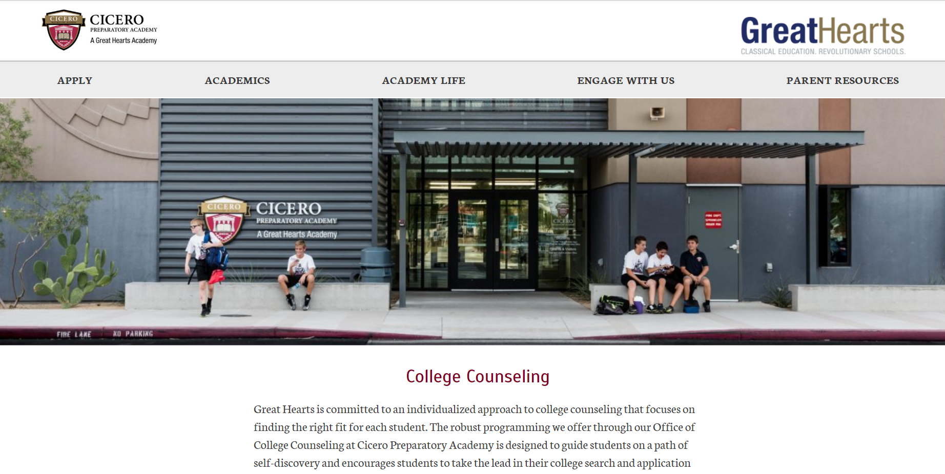
Cicero Prep Office of College Counseling
CiceroPrep.org
click “Academics”
click “College Counseling”
https://ciceroprep.greatheartsamerica.org/academics/college-counseling/
All college visits, events, resources including Naviance are linked here.

Slide 5
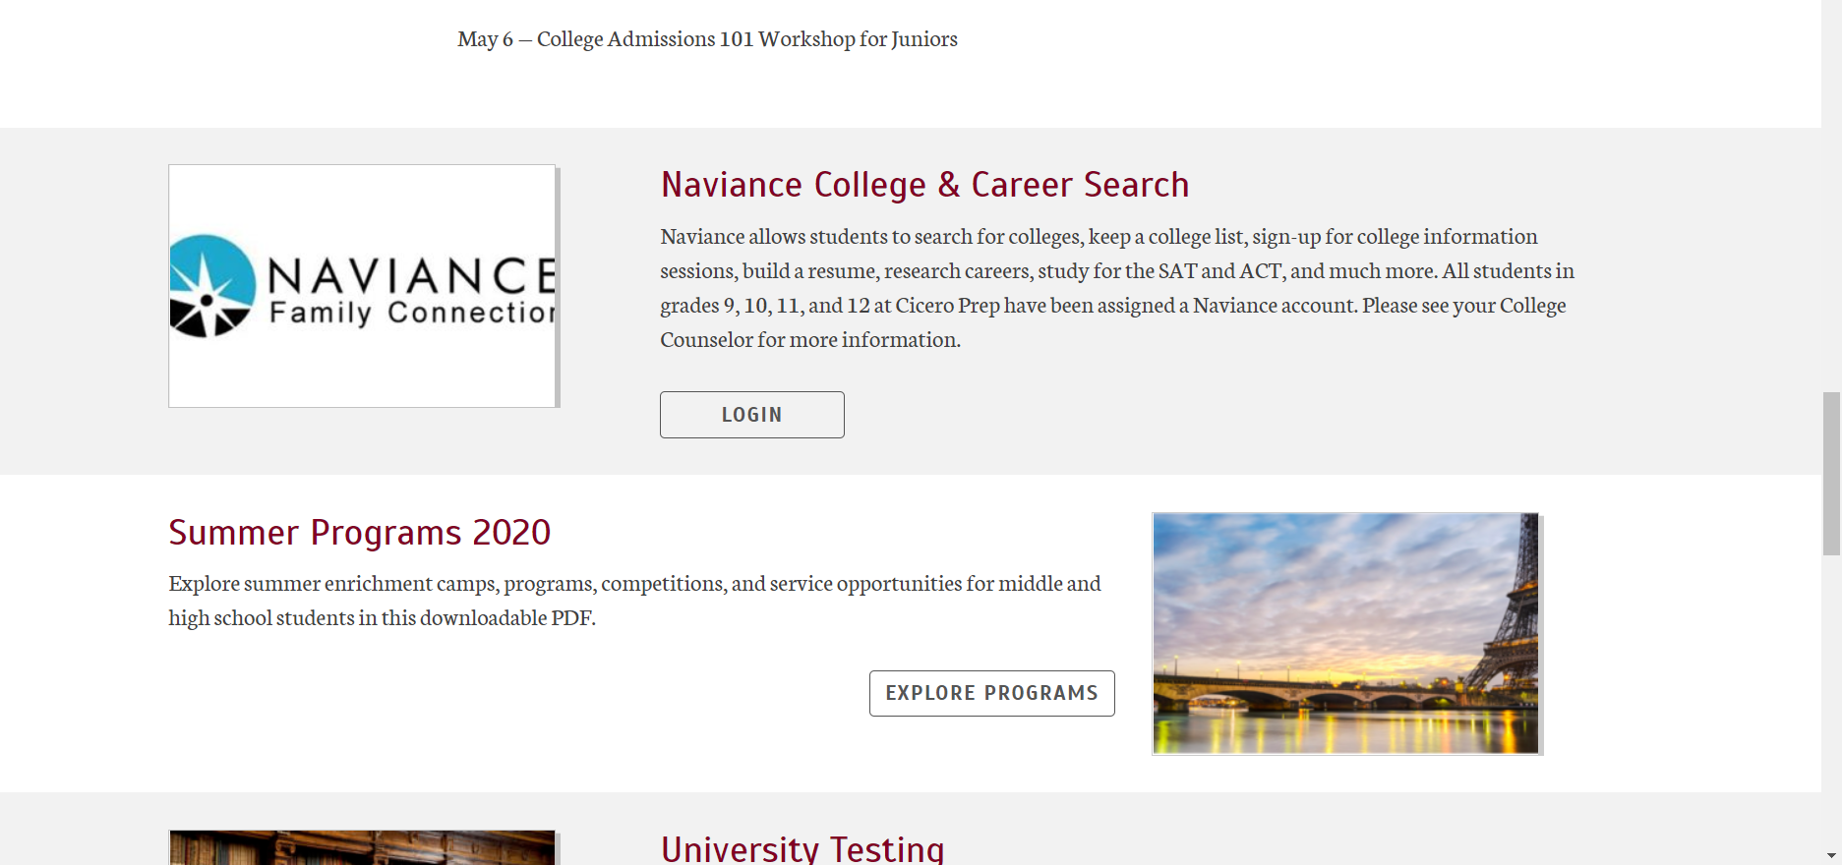
Naviance
Naviance: https://student.naviance.com/ciceropa
Career search
University search
Admission requirements to universities
Transcript request
Application checklist
Naviance is required for the Class of 2021 for all college applications.

Slide 6
What Selective Universities Look For
Grades in rigorous courses
ACT plus Writing or SAT*
SAT Subject Tests, two from different subjects*
Engineering: ”Math 2” and/or a Science recommended
Extra-curricular activities
unique, consistent, focus, creative, non-traditional leadership
Letters of recommendation
Two teachers plus College Counselor
* testing schedule may be adjusted to Fall 2020

Slide 7
What State Universities Look For
Course competency requirements
4 years math
4 years English (non-ESL/ELL courses)
3 years lab sciences (1 year each from biology, chemistry, earth science, integrated sciences or physics)
2 years social sciences (including 1 year American history)
2 years same second language
1 year fine arts or 1 year career and technical education
plus
top 25% in high school graduating class (Cicero does not rank students)
ASU: 3.00 GPA in competency courses (4.00 = "A"); UA: 2.00 GPA in competency courses; NAU 3.00 guaranteed admission; 2.50 considered
ACT: 22 (24 nonresidents)
SAT: 1120 (1180 nonresidents)

Slide 8
Types of Universities
Religious
Public
Private
Arts Schools
Military Academies
Community Colleges
Liberal Arts (nearly all in USA)
Selective
All Female/Male
Research Universities

Slide 9
Types of Applications
Early Decision
Binding commitment to attend, if accepted (October 15-November 15 deadlines)
Required College Counselor meeting with parents & student prior
Only permitted one Early Decision application per year
Early Action
Demonstrates student interest, no commitment to attend (November 1-December 1 deadlines)
Regular Deadline
January 1-February 1 deadlines
Rolling
Accepting applications until full

Slide 10
Parts of an Application
Counselor prepares & sends:
Cicero Transcript (grades 9-11)
Letters of Recommendation (2 teachers; 1 counselor)
School Profile
Mid-year Report (with Sem 1 grades)
Student prepares & sends:
Application online
Essay and Resume included
SAT/ACT/SAT Subject Tests
Financial documents (CSS profile &/or FAFSA)

Slide 11
Timeline for Class of 2021
Spring 2020
Meet with Counselor
Finish year strong
Practice for SAT/ACT & SAT Subject Tests
Create initial college list in
Write practice essay
Complete resume
Summer 2020
Take SAT/ACT & SAT Subject Tests
Explore universities
Improve essay
Research requirements
Narrow college list

Slide 12
Timeline for Class of 2021
Fall 2020
Take final SAT/ACT & SAT Subject Tests
Begin Common Application-August 1
Organize financial documents-October 1
Semester 1 grades matter
Spring 2021
Wait for and compare decisions
Decide and deposit by May 1, 2021
Schedule orientation
Apply for scholarships

Slide 13
What Can We Do Now?
Students
Set up 1:1 student meeting with counselor
Set up family meeting with counselor
Dedicate regular time weekly to college research
Parents
Ask students about their college hopes
Allow them space to focus on college research
Avoid discussing costs--for now
Ensure student has Naviance access

